Slide 1
Stock Price Prediction with SVM
Apr. 19
Renjie Qian

Slide 2
Paper List
(Shrunk version) N. Kercheval, A., Zhang, Y. (2013), Modeling High-frequency Limit Order Book Dynamics with Support Vector Machines.
(Detailed version) Zhang, Y. (2013), Modeling High-Frequency Order Book Dynamics with Support Vector Machines, Doctor of Philosophy Thesis, Florida State University, Tallahassee, USA.

Slide 3
Contents
Feature Engineering
Stock Price Prediction with SVM

Slide 4
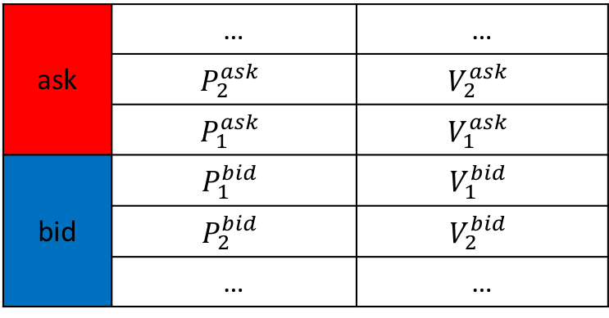
PART 1 Feature Engineering
Raw data: 10-level order book
At every time step , we have an order book
 | … | …
ask | $$P_{2}^{ask}$$ | $$V_{2}^{ask}$$
 | $$P_{1}^{ask}$$ | $$V_{1}^{ask}$$
 | $$P_{1}^{bid}$$ | $$V_{1}^{bid}$$
bid | $$P_{2}^{bid}$$ | $$V_{2}^{bid}$$
 | … | …

Slide 5
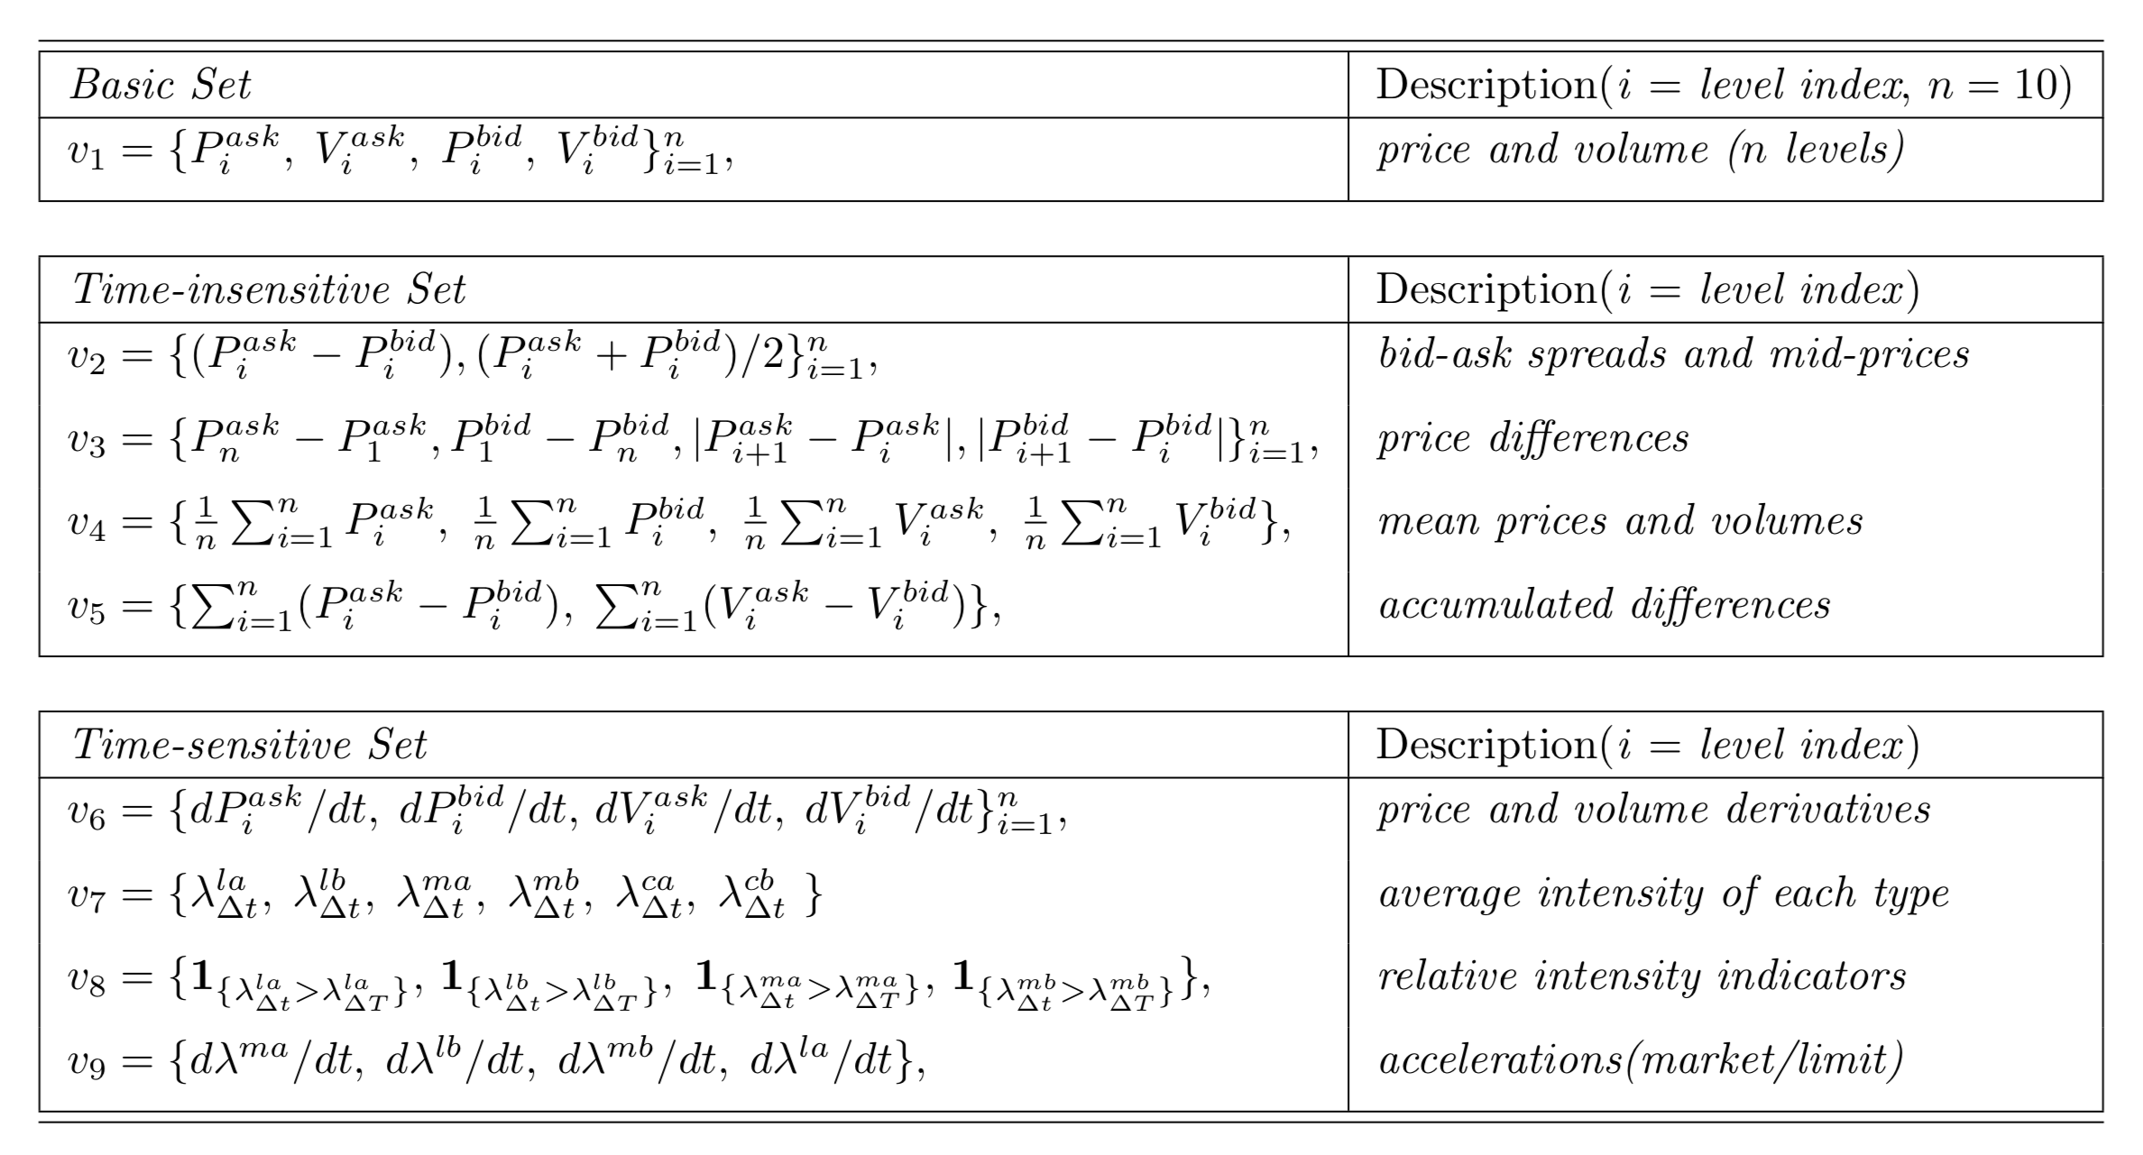
Features proposed by Kercheval and Zhang (2013):

Slide 6
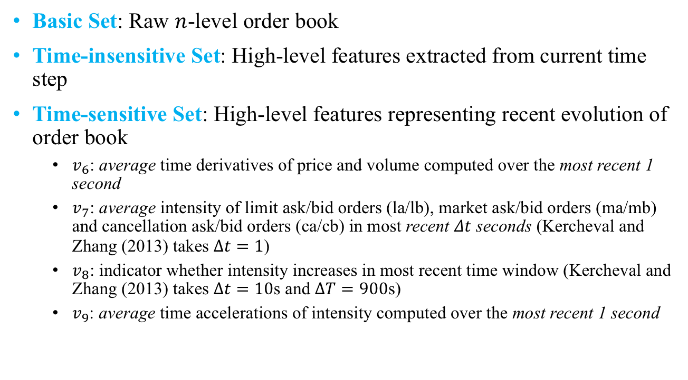
Details of Feature Engineering
Basic Set: Raw $n$-level order book
Time-insensitive Set: High-level features extracted from current time step
Time-sensitive Set: High-level features representing recent evolution of order book
$v_{6}$: average time derivatives of price and volume computed over the most recent 1 second
$v_{7}$: average intensity of limit ask/bid orders (la/lb), market ask/bid orders (ma/mb) and cancellation ask/bid orders (ca/cb) in most recent $Δt$ seconds (Kercheval and Zhang (2013) takes $Δt=1$)
$v_{8}$: indicator whether intensity increases in most recent time window (Kercheval and Zhang (2013) takes $Δt=10$s and $ΔT=900$s)
$v_{9}$: average time accelerations of intensity computed over the most recent 1 second

Slide 7
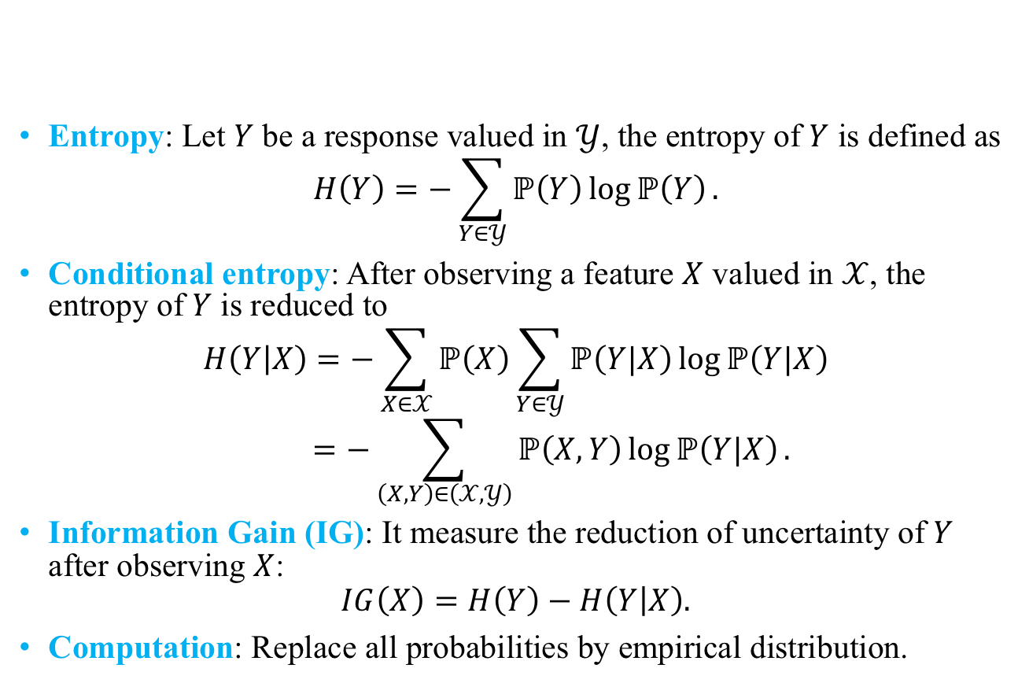
Feature Selection by Information Gain
Entropy: Let $Y$ be a response valued in $𝒴$, the entropy of $Y$ is defined as
$$H\left(Y\right)=−\sum_{Y∈𝒴}{ℙ\left(Y\right)\log{ℙ\left(Y\right)}}.$$
Conditional entropy: After observing a feature $X$ valued in $𝒳$, the entropy of $Y$ is reduced to
$$H\left(Y | X\right)=−\sum_{X∈𝒳}{ℙ\left(X\right)}\sum_{Y∈𝒴}{ℙ\left(Y|X\right)\log{ℙ\left(Y|X\right)}}$$
$$=−\sum_{\left(X, Y\right)∈\left(𝒳, 𝒴\right)}{ℙ\left(X, Y\right)\log{ℙ\left(Y|X\right)}}.$$
Information Gain (IG): It measure the reduction of uncertainty of $Y$ after observing $X$:
$$IG\left(X\right)=H\left(Y\right)−H\left(Y | X\right).$$
Computation: Replace all probabilities by empirical distribution.

Slide 8
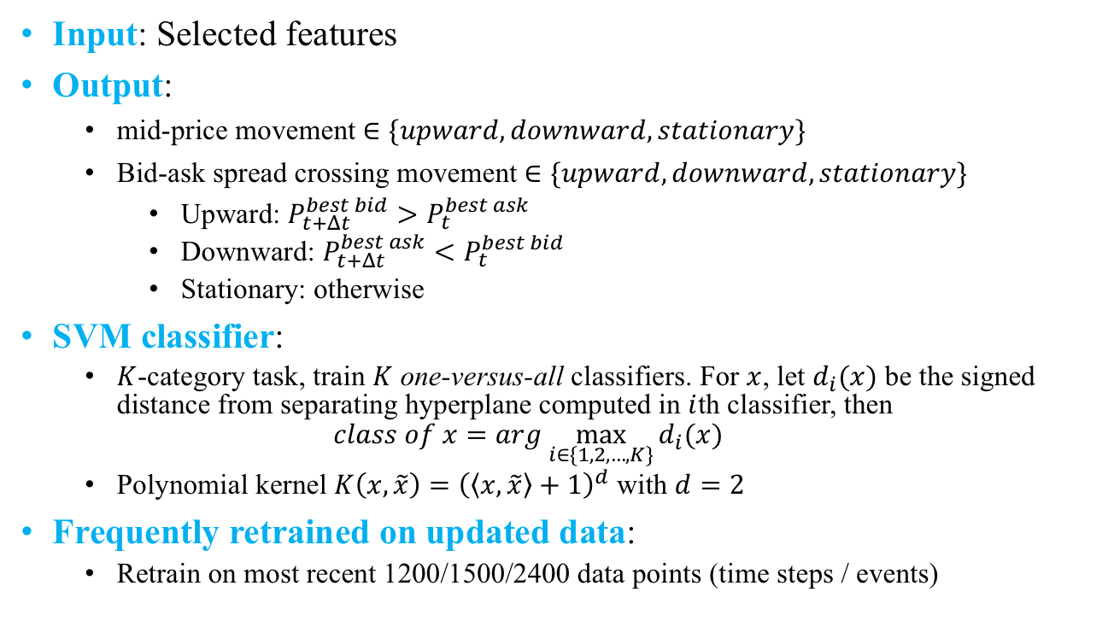
PART 2 Stock Price Prediction with SVM
Input: Selected features
Output:
mid-price movement $∈\{upward, downward, stationary\}$
Bid-ask spread crossing movement $∈\{upward, downward, stationary\}$
Upward: $P_{t+Δt}^{best bid}>P_{t}^{best ask}$
Downward: $P_{t+Δt}^{best ask}<P_{t}^{best bid}$
Stationary: otherwise
SVM classifier:
$K$-category task, train $K$ one-versus-all classifiers. For $x$, let $d_{i}(x)$ be the signed distance from separating hyperplane computed in $i$th classifier, then
$$class of x=arg \max_{i∈\{1, 2, …,K\}}{d_{i}(x)}$$
Polynomial kernel $K\left(x,\tilde{x}\right)={\left(\left\langle x,\tilde{x}\right\rangle +1\right)}^{d}$ with $d=2$
Frequently retrained on updated data:
Retrain on most recent 1200/1500/2400 data points (time steps / events)

Slide 9
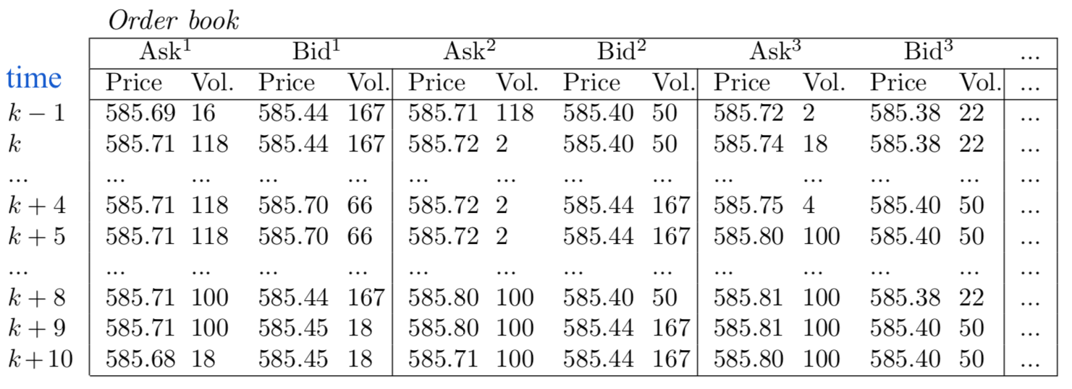
Experiments
Sample of Dataset

Slide 10
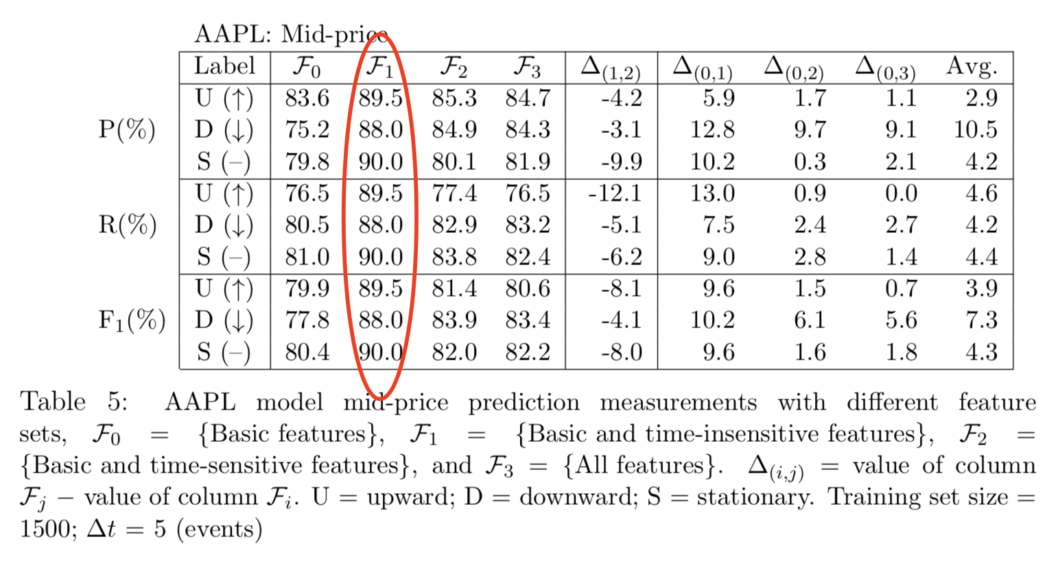
Feature selection
The need of selection

Slide 11
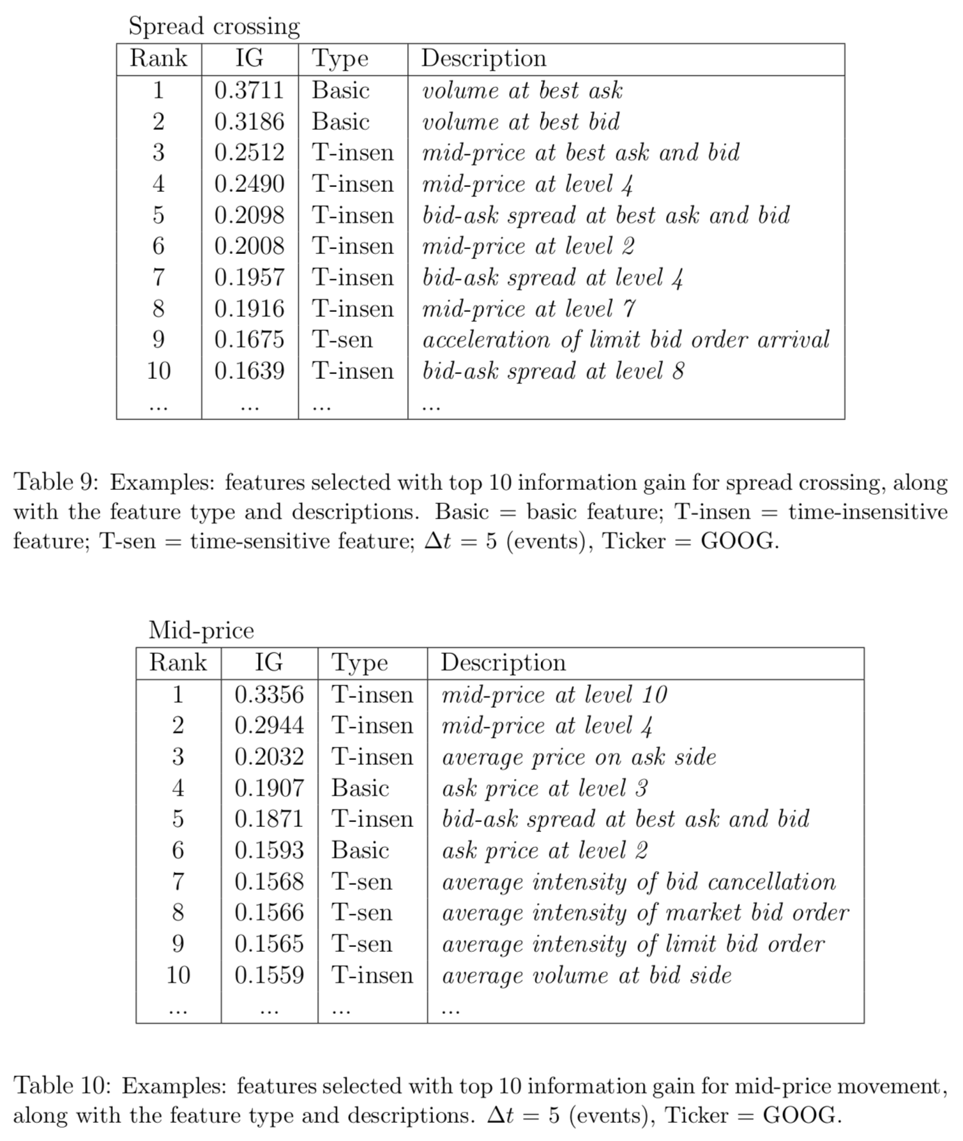
Select by information gain

Slide 12
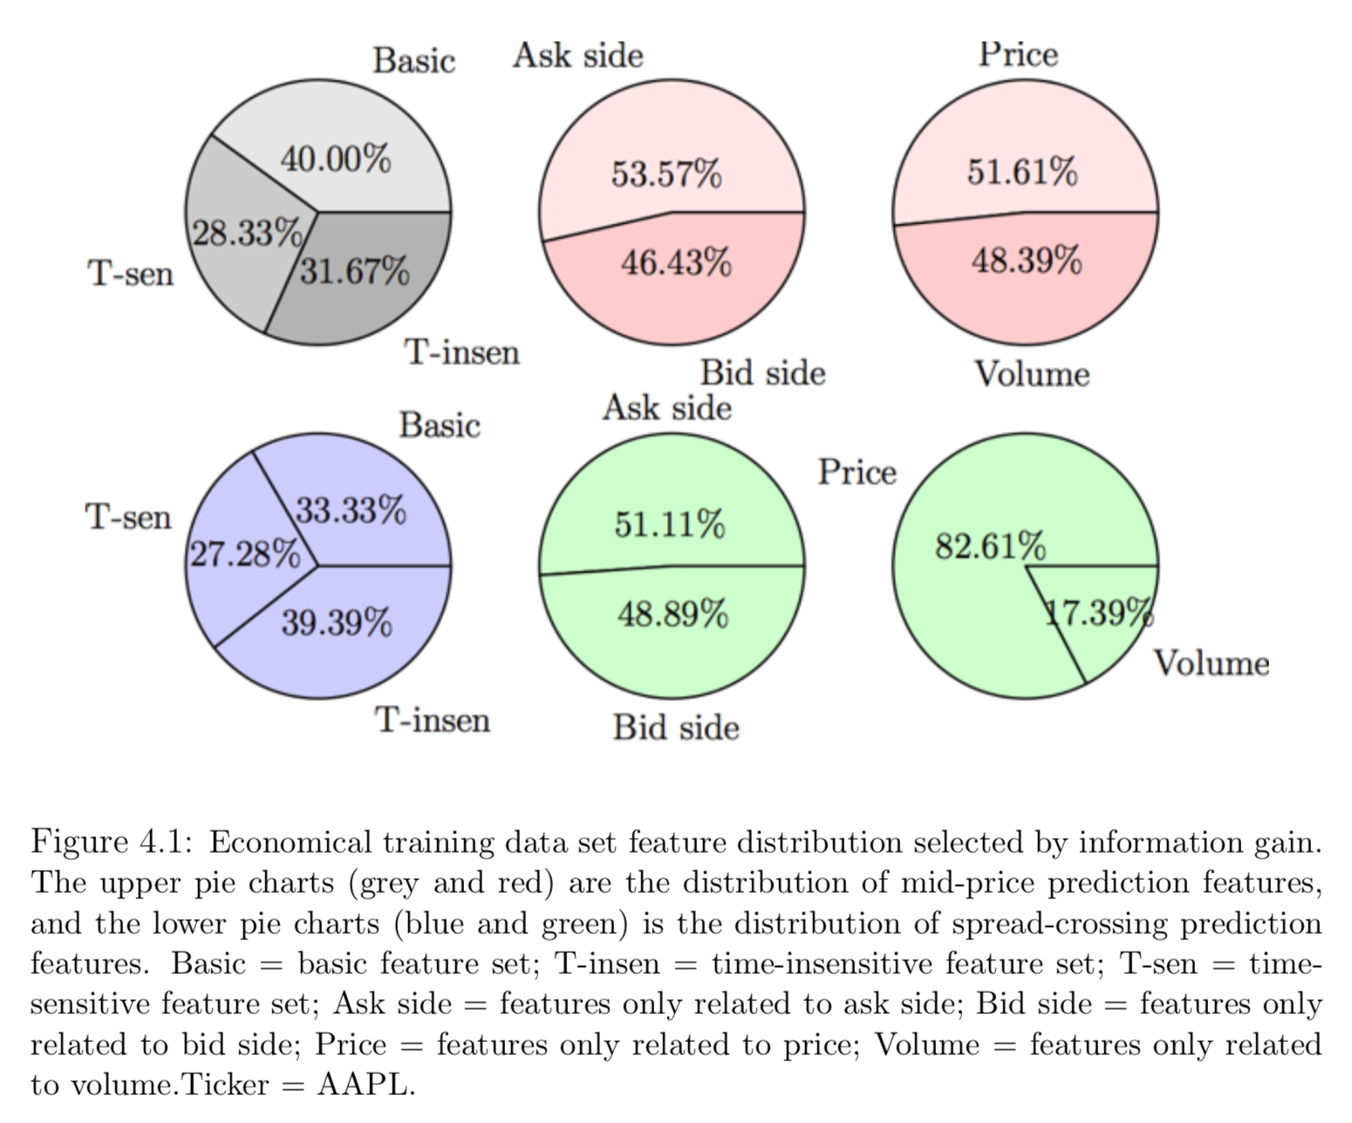
The distribution of selected features

Slide 13
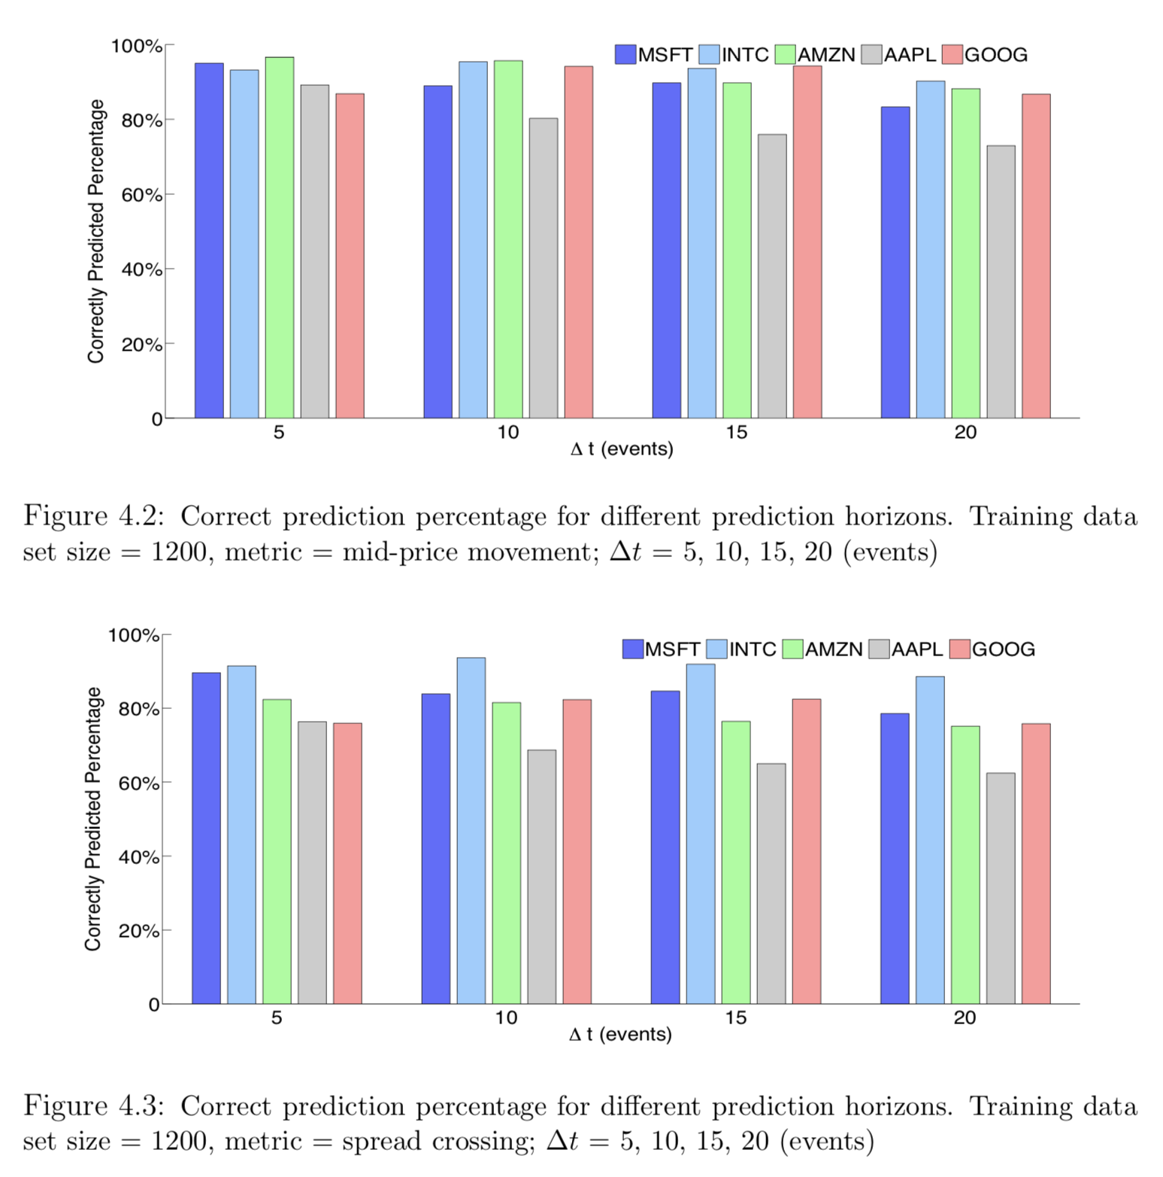

Prediction accuracy ($ℱ_{3}$ selected, sample size = 1200 time steps(events))

Slide 14
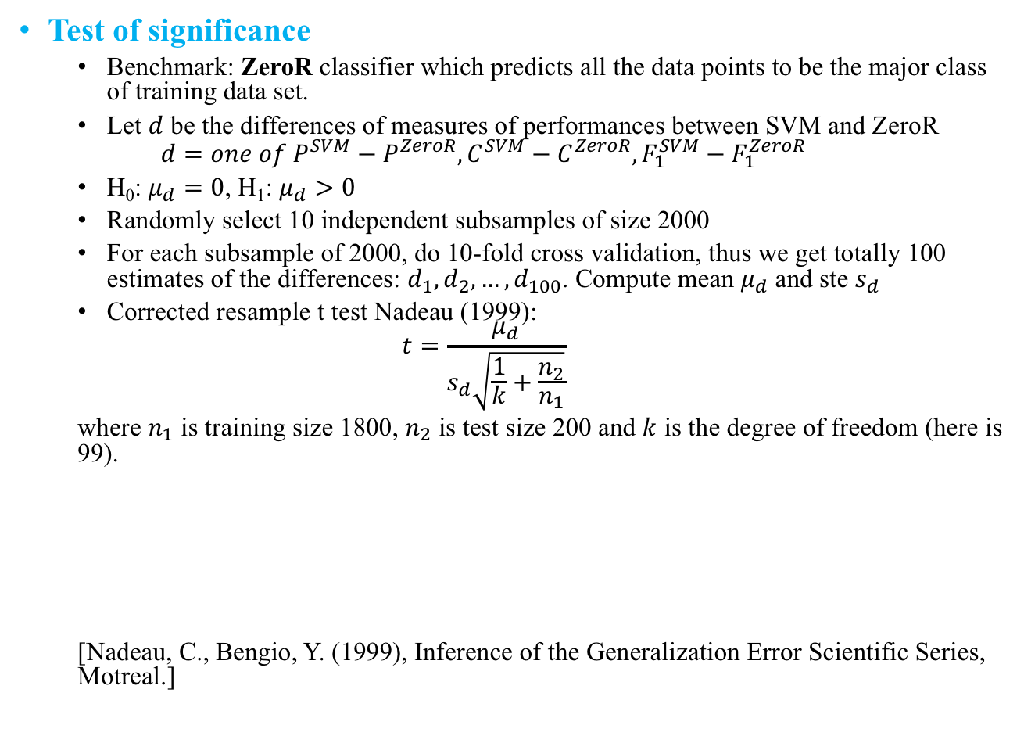
Test of significance
Benchmark: ZeroR classifier which predicts all the data points to be the major class of training data set.
Let $d$ be the differences of measures of performances between SVM and ZeroR
$$d=one of P^{SVM}−P^{ZeroR},C^{SVM}−C^{ZeroR},F_{1}^{SVM}−F_{1}^{ZeroR}$$
H₀: $μ_{d}=0$, H₁: $μ_{d}>0$
Randomly select 10 independent subsamples of size 2000
For each subsample of 2000, do 10-fold cross validation, thus we get totally 100 estimates of the differences: $d_{1}, d_{2},…, d_{100}$. Compute mean $μ_{d}$ and ste $s_{d}$
Corrected resample t test Nadeau (1999):
$$t=\frac{μ_{d}}{s_{d}\sqrt{\frac{1}{k}+\frac{n_{2}}{n_{1}}}}$$
where $n_{1}$ is training size 1800, $n_{2}$ is test size 200 and $k$ is the degree of freedom (here is 99).
[Nadeau, C., Bengio, Y. (1999), Inference of the Generalization Error Scientific Series, Motreal.]

Slide 15
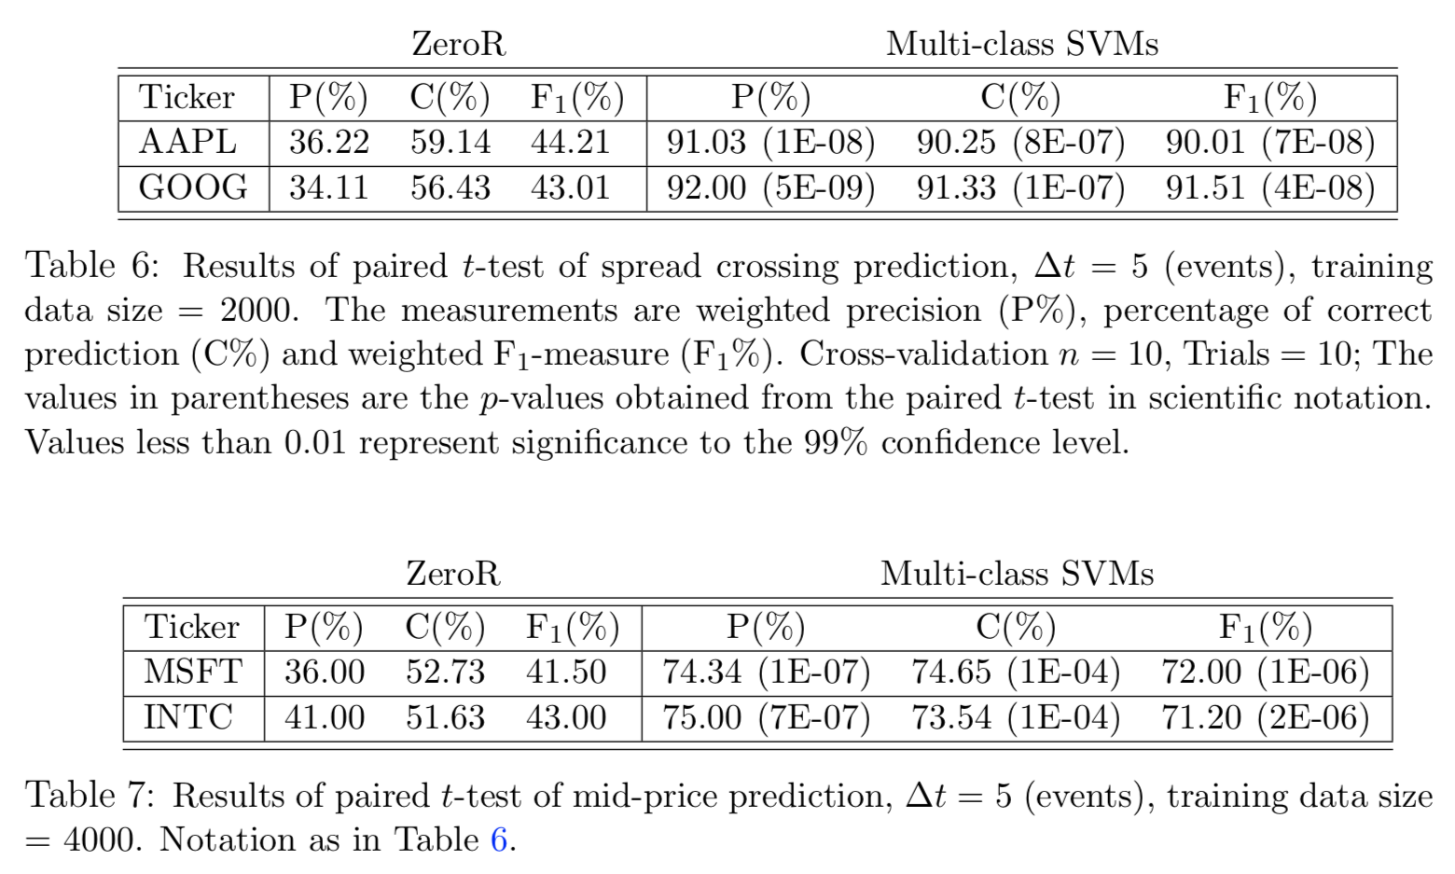

Slide 16
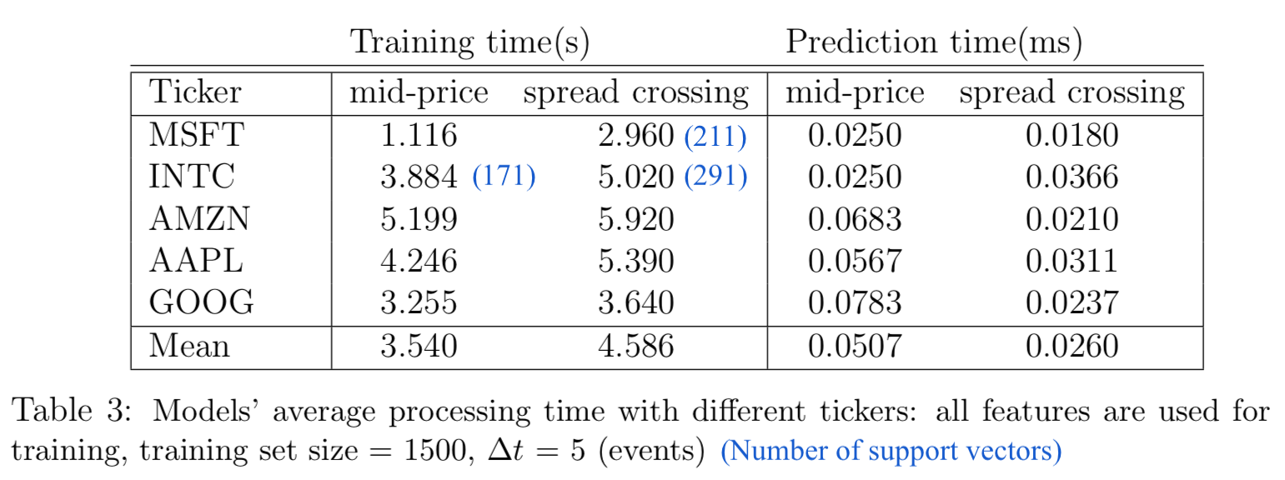
Platform: Linux, 2.9GHz i7, 8GB 1600MHz
Computational Time:

Slide 17
Summary
Good feature engineering & feature selection
Prediction based on current time step information
one-versus-all SVM classifier

